Slide 1
Economic Stabilisation 1. Monetary Policy 2. Fiscal Policy

Slide 2
Monetary Policy (MP)
It is framed by RBI.
The policy is related to cost and supply of money in the economy.
Objectives:-
Price stabilization
Exchange rate stabilization
Maintaining full employment rate
Economic growth

Slide 3
Objectives (Contd):-
Price stabilization:- inflation/ deflation should not be much. 3-4% inflation is normal for an economy. It shows economy is growing. 0% inflation shows recessionary condition.
Exchange rate stabilization:- If sudden change in exchange rate, RBI intervenes in market and try to maintain it.
if Rs. 80=$1 (Depreciation of rupee)
Rs. 75=$1 (Normal condition)
Rs. 70=$1 (Appreciation of rupee)
As demand of rupee goes down i.e. rupee depreciates, RBI starts selling $ in market from its foreign currency reserve. Hence rupee starts appreciating.
If high volatility, big problem for export and import.
If high depreciation, import price is high- bad condition
for export, it is good.

Slide 4
Contd…………………………………………..
3. Maintaining full employment rate:- 100% employment cant be possible. 3-4% is natural rate of unemployment. ( because of unemployability i.e. no skills or no capability of employees)
4. Economic growth:-
MP supplies money in market people take loans investment employment Income
Consumption + saving(demand in market) Economic growth

Slide 5
Instruments of MP (Tools)
Quantitative or general or Indirect
Qualitative or selective or Direct
Quantitative :- Different types-
a) Bank rate/Discount rate/Rapo rate- rate at which RBI lends money to commercial banks. It is minimum.
Reverse rapo rate:- rate at which commercial banks lends money to RBI. It is always less than rapo rate. (risk is involved in giving loan hence better to give to RBI than to any other bank)

Slide 6
Contd……………………………………………
b) Open market operations:- It refers to sale and purchase of securities in the money market by central bank.
Bond buying money to govt
c)Credit Reserve Ratio (CRR):- demand in time deposit. This includes changes in CRR and SLR.
CRR:- commercial bank has to keep it with RBI. Generally 6%. (4.75% in 2012)
SLR(Statutory liquidity ratio):-3-15% commercial bank has to keep it with itself. Today it is around 24%.
So, 30% is saved and 70% currency is circulated in market and it is maintained every quarterly.
In USA, SLR is not there. So 90% currency is there in market.

Slide 7
Qualitative:-
Changing margin requirements:- in this policy, borrowers are given less money against specified securities. Loan taker has to pay some amount as well.
Credit rationing:- selective credit control. RBI can advise commercial banks not to give loans in areas related to speculative activity (hype) is seen.
Moral persuasion/moral suasion:- RBI issues letters to commercial banks asking them to control credit.
Direct control:- central bank takes control of all commercial banks if requirement is not fulfilled.

Slide 8
To maintain price stability, full employment or economic growth in market…….2 types of MP:-
Expansionary monetary policy:- used to overcome recession or depression
CRR SLR
BUY SECURITIES
BANK RATE
Restrictive/Contractionary monetary policy:-
Reverse of expansionary policy

Slide 9
Fiscal Policy (FP)
Revenue and expenditure of govt.
Finance minister sets FP.
Revenue generation through taxes and expenditure by the name of public/general expenditure policy.
In developed countries, it is used as instrument to achieve full employment and economic stability.
In developing countries, it is used to set up economic growth rate.

Slide 10
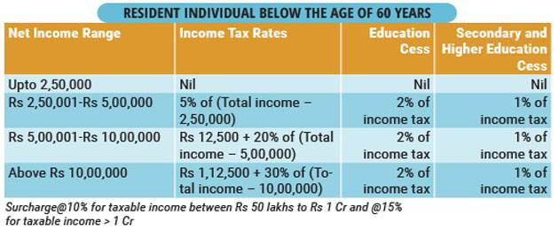
Operation of fiscal policy
Taxation:- in India it is PROGRESSIVE RATE of taxation. Tax with in income of people. It tries to the inequality of society. With the help of public expenditure programs govt tries to shift the money to poorer.

Slide 11
Contd……………………………………….
Public expenditure programmes:-
Used in recession.
Social and economic infrastructure
Education health welfare programmes

Slide 12
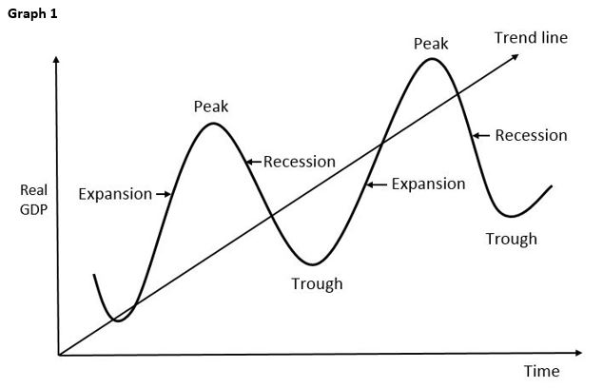
Tools of F.P.
1) Contracyclic business cycle:- counter effecting the business cycle. (Trough is depression)

Slide 13
Budget deficit policy:- (Fiscal deficit)
FP which is followed during recession.
During 2008-09= 6%
In 2019, it was 4.6%
Deficit Financing:- from where we are going to finance for the deficit.
b)Surplus budget:- budgetary policy followed in boom. Rarely followed in developing countries.

Slide 14
C) Balance budget multiplier:- when change in taxation is equal to change in expenditure.
Neither recession nor boom condition.
2) Compensatory fiscal policy:- govt doesn’t need to enter the market. Condition changes automatically.
During recession, more people come under BPL hence expenditure will .
Govt spend on public expenditure programmes. Eg:- Saksharata abhiyaan etc.
During surplus, as income , taxes although not raised but public will move to higher tax slabs.

Slide 15
